Slide 1

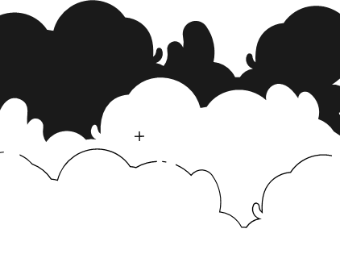
PRINCIPLES OF ARTIFICIAL INTELLIGENCE
SOF106
DR SHAMINI RAJA KUMARAN
PROBLEM SOLVING SEARCH TECHNOLOGY
-UNINFORMED SEARCH-
www.website.com
PREPARED BY DR SHAMINI

Slide 2
XMUM VISION
Xiamen University Malaysia aspires to become a university with a distinct global outlook, featuring first-class teaching and research, and embracing cultural diversity.
XMUM MISSION
To nurture young talents with dignity and wisdom, turning them into fine citizens of the region who will contribute to the prosperity of the people and social progress of Malaysia, China and Southeast Asia.To nurture young talents with dignity and wisdom, turning them into fine citizens of the region who will contribute to the prosperity of the people and social progress of Malaysia, China and Southeast Asia.

Slide 3
PROBLEM SEARCH SOLVING TECHNOLOGY
SEARCH STRATEGIES
1. UNINFORMED SEARCHING
2. INFORMED SEARCHING + LOCAL SEARCH
3. ADVANCED SEARCHING (HILL CLIMBING+SIMULATED ANNEALING)
4. ADVERSARIAL SEARCHING

Slide 4
UNINFORMED SEARCHING
Breadth-first
Depth-first
Uniform-cost
Iterative deepening depth-first

Slide 5
UNINFORMED SEARCHING
Uninformed search strategies use only the information available in the problem definition.
While searching you have no clue whether one non-goal state is better than any other.
Your search is blind.
You don’t know if your current exploration is likely to be fruitful.

Slide 6
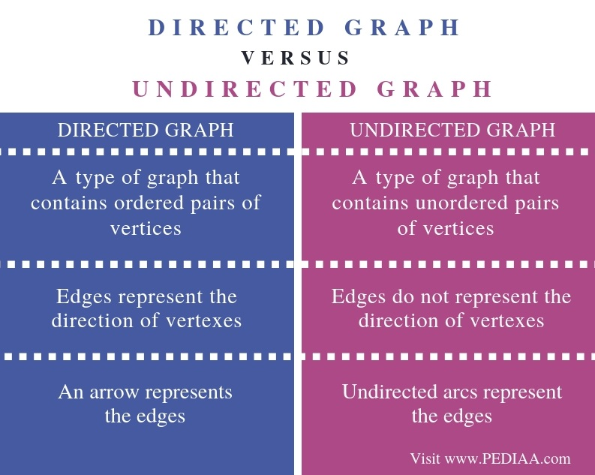
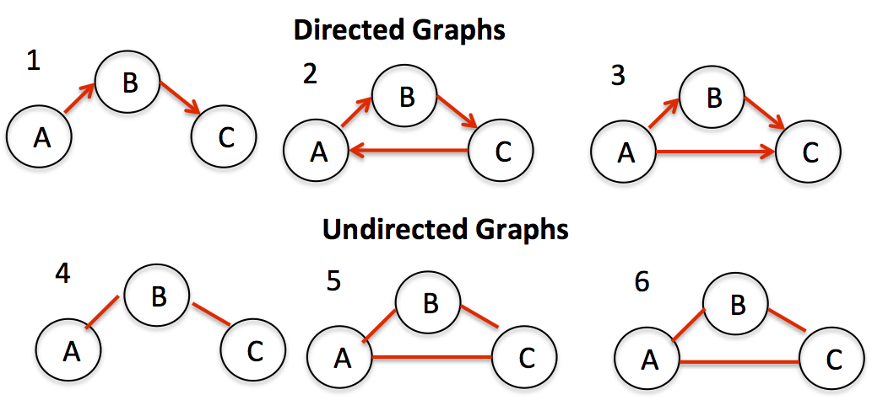
LET’S UNDERSTAND GRAPHS

Slide 7
1. BREADTH FIRST SEARCH (BFS)
BFS is a simple strategy in which the root node is expanded first, then all the successors of the root node are expanded next, then their successors, etc.
BFS is an instance of the general graph-search algorithm in which the shallowest unexpanded node is chosen for expansion.
This is achieved by using a FIFO queue for the frontier.
Accordingly, new nodes go to the back of the queue, and old nodes, which are shallower than the new nodes are expanded first.

Slide 8
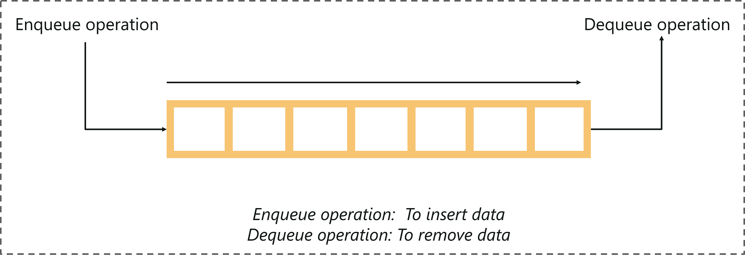
1. BREADTH FIRST SEARCH (BFS)
Expand shallowest unexpanded node
Implementation:
Frontier is a FIFO queue, example, new successors go at end
A queue is an abstract data structure that follows the First-In-First-Out methodology (data inserted first will be accessed first).
It is open on both ends, where one end is always used to insert data (enqueue) and the other is used to remove data (dequeue).

Slide 9
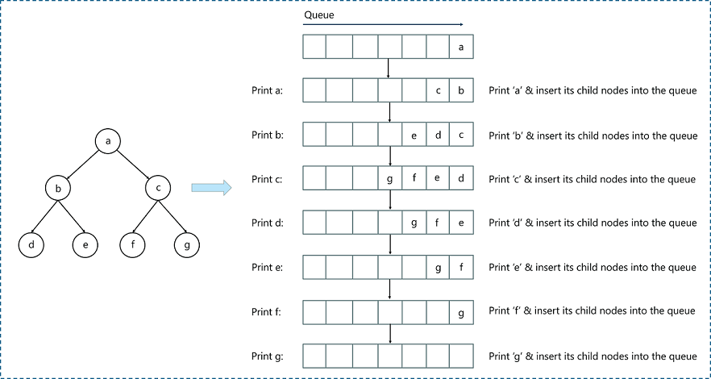
1. BREADTH FIRST SEARCH (BFS)
EXAMPLE 1

Slide 10
1. BREADTH FIRST SEARCH (BFS)
PROPERTIES
Complete? Yes (if b is finite)
Time? 1+b+b²+b³+… +b^{d} = O(b^{d})
Space? O(bd) (keeps every node in memory)
Optimal? Yes (if cost = 1 per step) (when all steps cost equally)
Space is the bigger problem (more than time)
Note:
b: branching factor (maximum number of successors of any node)
d: depth (of the shallowest goal node)
m: maximum length of any path in the state space.

Slide 11
2. DEPTH FIRST SEARCH (DFS)
DFS always expands the deepest node in the current frontier of the search tree. The search proceeds immediately to the deepest level for the search tree, where the nodes have no successors.
As those nodes are expanded, they are dropped from the frontier, so then the search “backs up” to the next deepest node that still has unexplored successors.
DFS is an instance of the general graph-search algorithm which uses a LIFO queue. This means that the most recently generated node is chosen for expansion.
Because of the recursive nature, stack data structure can be used to implement the DFS algorithm.
For DFS, fringe is a last-in-first-out (LIFO) queue new successors go at beginning of the queue.

Slide 12
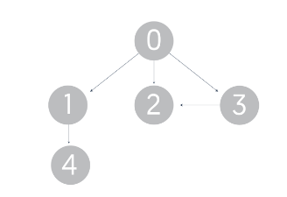
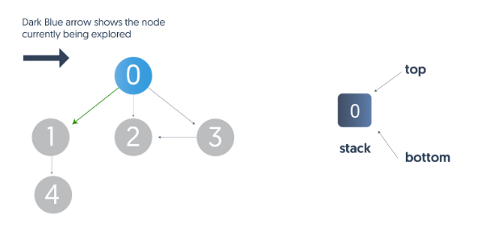
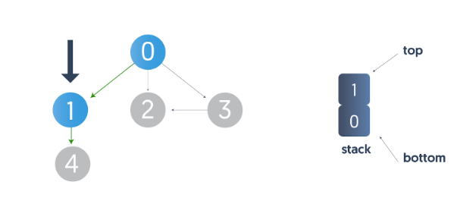
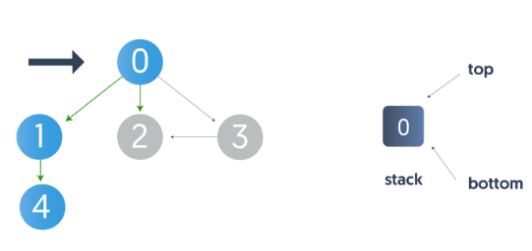
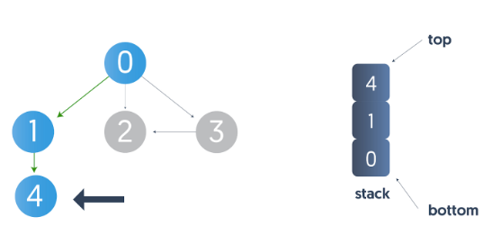
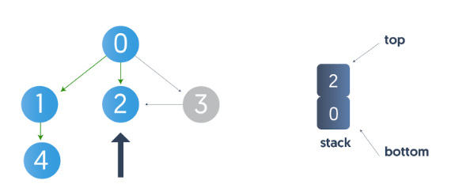
2. DEPTH FIRST SEARCH (DFS)
EXAMPLE 2
As node 4 does not have child, we backtrack to 1 then 0

Slide 13
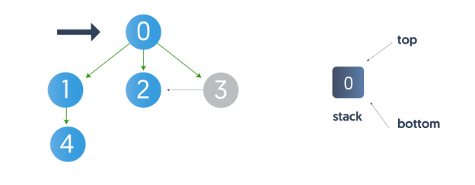
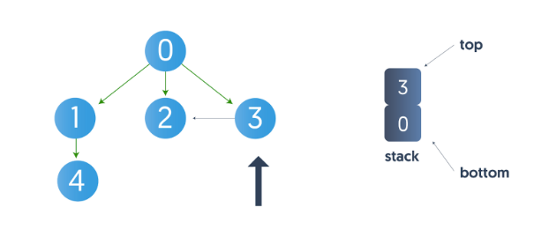
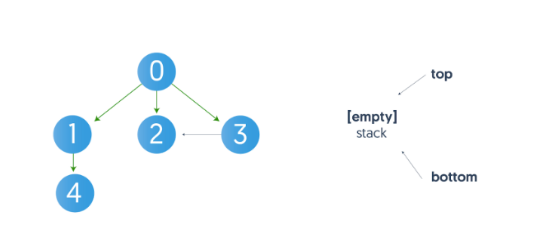
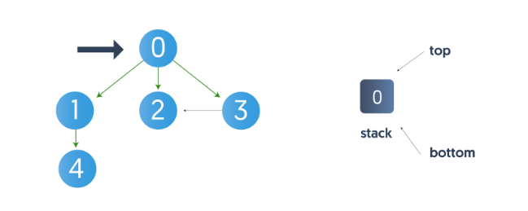
2. DEPTH FIRST SEARCH (DFS)
EXAMPLE 2
Node 2 does not have any neighbors — we backtrack to node 0.
Node 3 has a neighbor, node 2, but since it's already visited; so, we don’t go over it again and backtrack to node 0. Node 0 does not have any unvisited neighbors left.
Traversed path: 0-1-4-2-3

Slide 14
2. DEPTH FIRST SEARCH (BFS)
PROPERTIES
Complete? No: fails in infinite-depth spaces
Time? O(b^{m}) with m=maximum depth
Space? O(bm), i.e., linear space! (we only need to remember a single path + expanded unexplored nodes)
Optimal? No (It may find a non-optimal goal first)
Note:
b: branching factor (maximum number of successors of any node)
d: depth (of the shallowest goal node)
m: maximum length of any path in the state space.

Slide 15
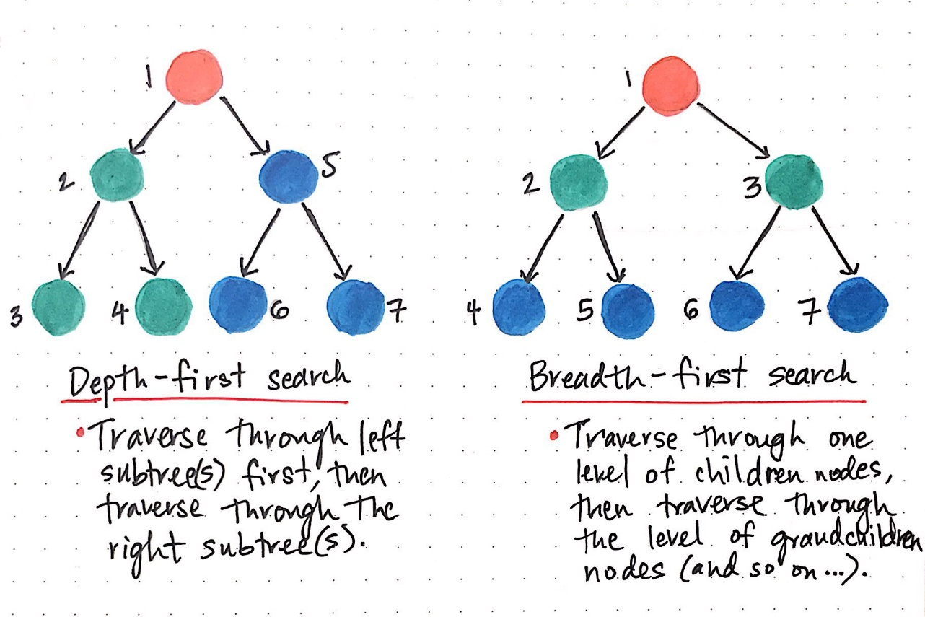
COMPARING BFS & DFS
Time complexity: same, but
In the worst-case BFS is always better than DFS
Sometime, on the average DFS is better if:
many goals, no loops and no infinite paths
BFS is much worse memory-wise
DFS is linear space
BFS may store the whole search space.
In general
BFS is better if goal is not deep, if infinite paths, if many loops, if small search space
DFS is better if many goals, not many loops,
DFS is much better in terms of memory

Slide 16
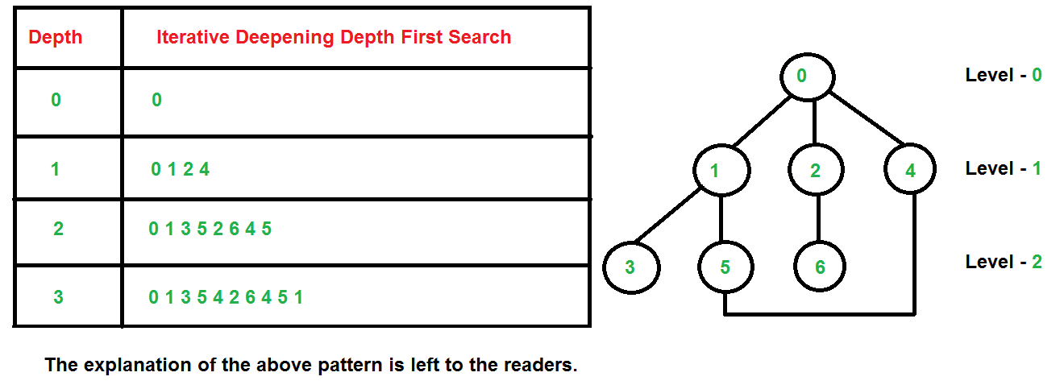
3. ITERATIVE DEEPENING SEARCH
Run multiple DFS searches with increasing depth-limits
Iterative deepening search
L = 1
While no solution, do
DFS from initial state S₀ with cutoff L
If found goal,
stop and return solution,
else, increment depth limit L

Slide 17
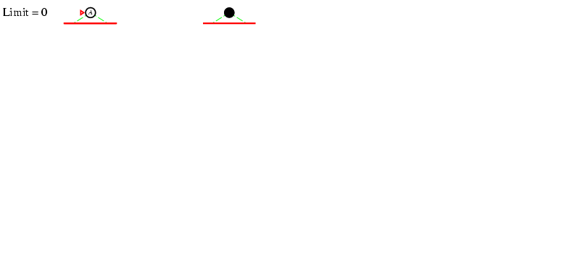
3. ITERATIVE DEEPENING SEARCH
EXAMPLE 3; L=0

Slide 18
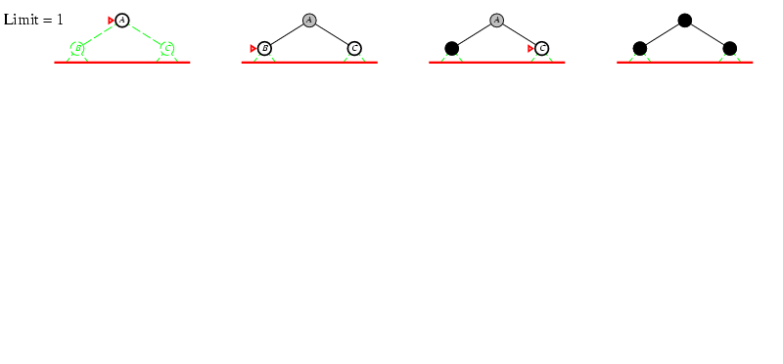
3. ITERATIVE DEEPENING SEARCH
L=1

Slide 19
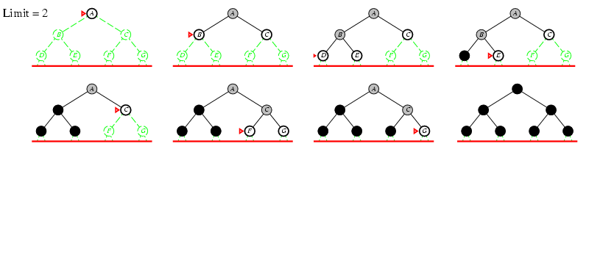
3. ITERATIVE DEEPENING SEARCH
L=2

Slide 20
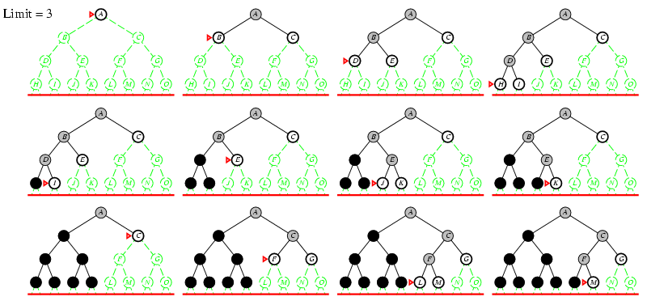
3. ITERATIVE DEEPENING SEARCH
L=3

Slide 21
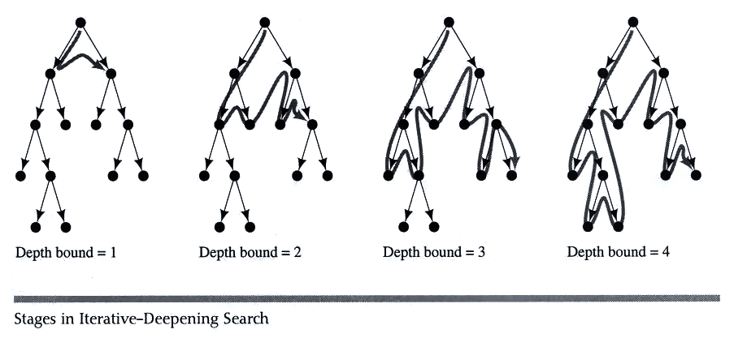
3. ITERATIVE DEEPENING SEARCH

Slide 22
3. ITERATIVE DEEPENING SEARCH
Space complexity = O(bd)
(since its like depth first search run different times, with maximum depth limit d)
Time Complexity
b + (b+b²) + .......(b+....b^{d}) = O(b^{d}) (asymptotically the same as BFS or DFS to limited depth d in the worst case)
Complete?
Yes
Optimal
Only if path cost is a non-decreasing function of depth
IDS combines the small memory footprint of DFS, and has the completeness guarantee of BFS.

Slide 23
4. UNIFORM COST SEARCH
Optimality: path found = lowest cost
Algorithms so far are only optimal under restricted circumstances
Let g(n) = cost from start state S to node n
Uniform Cost Search:
Always expand the node on the fringe with minimum cost g(n)
Note that if costs are equal (or almost equal) will behave similarly to BFS

Slide 24
4. UNIFORM COST SEARCH
Optimality: path found = lowest cost
Algorithms so far are only optimal under restricted circumstances
Let g(n) = cost from start state S to node n
Uniform Cost Search:
Always expand the node on the fringe with minimum cost g(n)
Note that if costs are equal (or almost equal) will behave similarly to BFS

Slide 25
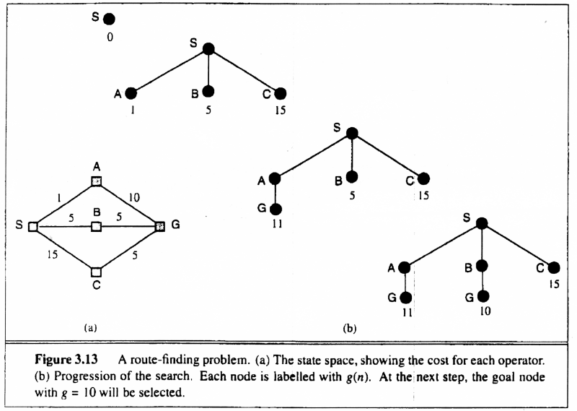
4. UNIFORM COST SEARCH
Uniform-cost Search: Expand node with smallest path cost g(n).
Proof Completeness:
Given that every step will cost more than 0,
and assuming a finite branching factor, there
is a finite number of expansions required before
the total path cost is equal to the path cost of the
goal state. Hence, we will reach it.
Proof of optimality given completeness:
Assume UCS is not optimal.
Then there must be an (optimal) goal state with
path cost smaller than the found (suboptimal) goal
state (invoking completeness).
However, this is impossible because UCS would
have expanded that node first by definition.
Contradiction.

Slide 26
4. UNIFORM COST SEARCH

Slide 27
4. UNIFORM COST SEARCH
Implementation: frontiers = queue ordered by path cost
Equivalent to breadth-first if all step costs all equal.
Complete? Yes, if step cost ≥ 0
(otherwise it can get stuck in infinite loops)
Time? # of nodes with path cost ≤ cost of optimal solution.
Space? # of nodes with path cost ≤ cost of optimal solution.
Optimal? Yes, for any step cost ≥ 0

Slide 28
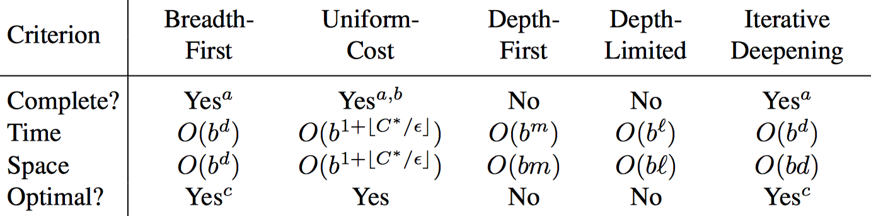
SUMMARY OF UNINFORMED SEARCH

Slide 29
THANK YOU
www.website.com
PREPARED BY DR SHAMINI

